Slide 1
On Conservation, Symmetry, and the Beautiful Theorem of Emmy Noether
Conrad Schiff

Slide 2
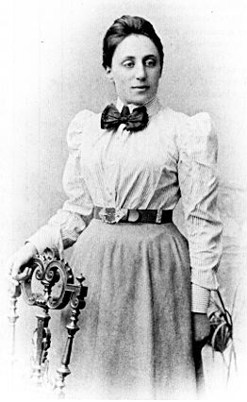
In a Nutshell
The aim of this talk is to introduce and explore the following idea (Noether’s theorem) [1]
  “To every differentiable symmetry generated by local actions, there corresponds a conserved current.’’ [2]
The theorem is based on advanced concepts from field theory, variational calculus and differential geometry
Despite that, a simple physical meaning exists and can be easily understood
C. Schiff/595 3/26/08
Conservation, Symmetry, and Noether

Slide 3
Outline of the Talk
A brief biography of Emmy Noether
Conservation principles
  Conserved quantities: definition and use
  Conservation and the Kepler problem
  Additional conserved quantities
Symmetry
  Discrete and continuous symmetry
  The action
  Statement of the theorem
  Familiar conservation/symmetry pairs
  Why all the fuss?
  ‘A rose by any other name…’
Useful references
C. Schiff/595 3/26/08
Conservation, Symmetry, and Noether

Slide 4
Brief Biography of Emmy Noether (1/2)
Amalie Emmy Noether was born on March 23, 1882 in Erlangen, Bavaria [3]
Mathematics, the Noether family business [3]
  Max (father): math professor at University of Erlangen
  Fritz (younger brother): mathematician at University of Tomsk
  Gottfried (nephew): statistician at various US universities
Although Erlangen did not allow women to enroll until 1904, Emmy had been allowed to attend math classes from 1900 [3-4]
She earned her doctorate in 1907 and quickly built her reputation [3-4]
  Abstract algebra
  Variational principles and Lie Symmetries
  General relativity
C. Schiff/595 3/26/08
Conservation, Symmetry, and Noether

Slide 5
Brief Biography of Emmy Noether (2/2)
Emmy moved to Gottingen in 1915 but was not allowed to teach [3-4]
  Academic senate rejected her because she was a women
  Hilbert: “I don’t see why the sex of the candidate is relevant – this is after all an academic institution not a bath house”
Gottingen finally relented in 1919 [3]
Emmy remained there until 1933 when she fled the Nazis [3]
She came to the US and settled at Bryn Mawr [3]
She died of surgery-related complications in 1935 at the age of 53 [4]
Key paper Invariante Variationsprobleme, 1918
C. Schiff/595 3/26/08
Conservation, Symmetry, and Noether

Slide 6

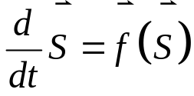
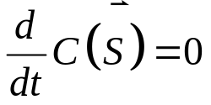
Conserved Quantities: Definition and Use
Consider a mechanical system, described by a state that obeys a set of equations of motion of the form
What is a conserved quantity?
  A combination of state variables, call it C, that doesn’t change as the system evolves
  A mechanical system with d degrees-of-freedom can have at most 2d – 1 conserved quantities [5]
Why are conserved quantities useful?
  Conserved quantities provide ways of solving problems without explicitly solving the EOMs [6]
  Provide checks for numerical simulations
  Provide global bounds on the motion
C. Schiff/595 3/26/08
Conservation, Symmetry, and Noether

Slide 7
Conservation and the Kepler Problem (1/4)
The Kepler problem (6 DOFs)
The system is completely determined by conserved quantities
  possesses 12 state variables (position and velocity for both masses)
  Four types of conservation principles reduce the problem to one dimension
    Momentum
    Energy
    Angular Momentum
    Laplace-Lenz-Runge (LLR) (eccentricity) vector
_{z}
m₂
_{y}
m₁
_{x}
C. Schiff/595 3/26/08
Conservation, Symmetry, and Noether

Slide 8
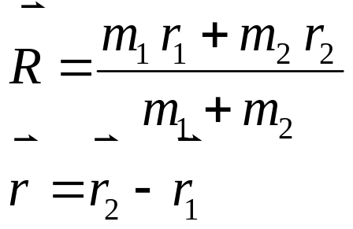
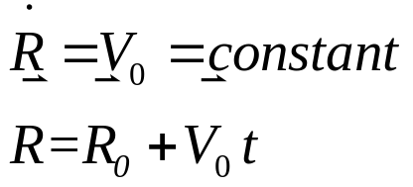

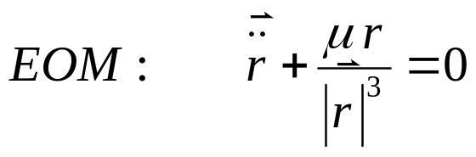
Conservation and the Kepler Problem (2/4)
Conservation of Momentum
  First define center-of-mass and relative coordinates
  No external forces on the system implies that the center-of-mass coordinates obey simple linear motion
  Can arbitrarily set
Equations of motion for the relative coordinate is now:
C. Schiff/595 3/26/08
Conservation, Symmetry, and Noether

Slide 9
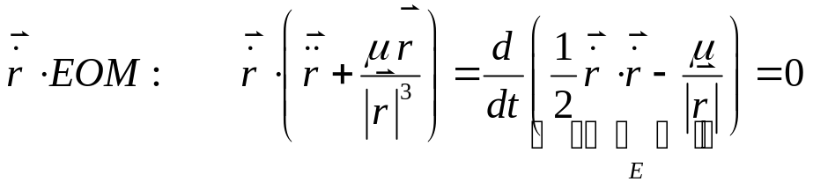
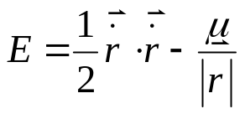
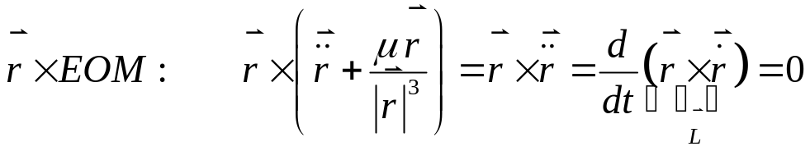

Conservation and the Kepler Problem (3/4)
Conservation of Energy
  ‘dot’ the EOM with the relative velocity
  Conserved quantity is the energy (1)
Conservation of the angular momentum
  ‘cross’ the EOM with the relative position
  Conserved quantity is the angular momentum (3)
C. Schiff/595 3/26/08
Conservation, Symmetry, and Noether

Slide 10
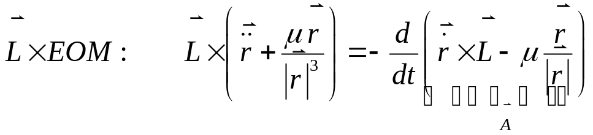
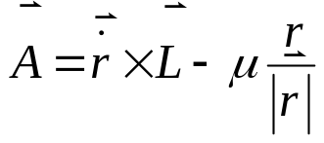
Conservation and the Kepler Problem (4/4)
Conservation of the LLR vector
  Now a very inspired guess leads on to ‘cross’ the EOM by the angular momentum
  Conserved quantity is the LLR vector (3)
The LLR vector constancy means that the orbit is closed (the line of apsides is fixed in space)
Since there are two constraints equations relating the energy, angular momentum, and LLR vector, there are 5 conserved quantities
These 5 quantities can be mapped to the 5 Keplerian elements that are conserved [7]
C. Schiff/595 3/26/08
Conservation, Symmetry, and Noether

Slide 11
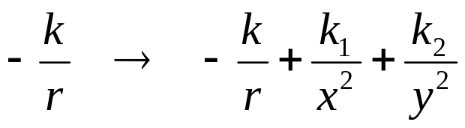
Additional Conserved Quantities (1/2)
The Kepler problem and the simple harmonic oscillator are prototype systems since they have enough conserved quantities to completely specify the motion (maximally superintegrable) [6]
But how do you know when a system possesses 2d-1 conserved quantities? Consider modified Kepler
How many conserved quantities does this system possess?
How do you find them?
(FYI – the potential above is maximally superintegrable as well [6])
C. Schiff/595 3/26/08
Conservation, Symmetry, and Noether

Slide 12
Discrete and Continuous Symmetries
Before going on to relate symmetries to conservation laws some definitions are in order
A discrete symmetry is given by isolated values of a transformation parameter (i.e. rotation angle)
Only discrete values of the rotation angle leave a square invariant (labels added only for convenience)
Continuous symmetry allows the rotation angle to take on any value
1
1
1
1
1
1
1
1
1
C. Schiff/595 3/26/08
Conservation, Symmetry, and Noether

Slide 13

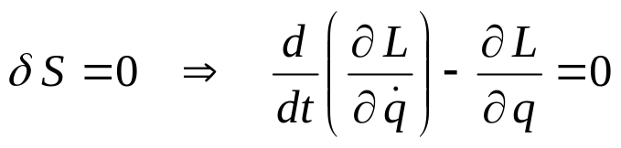
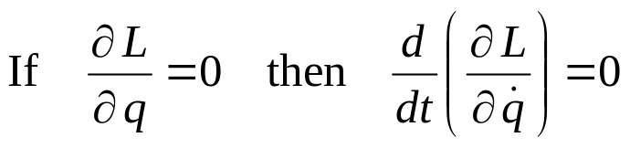
The Action
Noether’s theorem applies to systems whose EOMs can be obtained from an action principle
The EOMs are obtained by setting the first variation to zero yielding the Euler-Lagrange equations
A first clue for symmetry comes by simply noting that:
C. Schiff/595 3/26/08
Conservation, Symmetry, and Noether

Slide 14

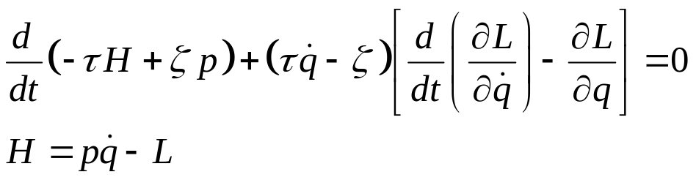
Statement of the Theorem
Noether’s theorem tells us that if the action doesn’t change (‘is invariant’) to a continuous symmetry then there is a conserved quantity
The symmetries are found in both the independent an dependent variables in the variational principle
For classical mechanics, time is the independent variable and the generalized coordinates are the dependent variables
Under these transformations (see backup material), one finds the following differential equation (Noether’s theorem)
C. Schiff/595 3/26/08
Conservation, Symmetry, and Noether

Slide 15
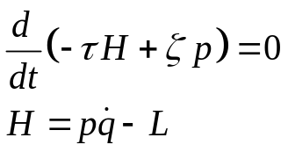
Familiar conservation/symmetry pairs
For physical motion, the term in the square brackets is the usual Euler-Lagrange equation and is identically zero
By interrogating this equation, one can get the conserved quantities and the symmetries in a methodical way
Conserved Quantity | Symmetry
Energy/Hamiltonian | Time translation (τ = 1, ζ = 0) [1]
Linear Momentum | Spatial translation (τ = 0, ζ = 1) [1]
Angular Momentum | Rotational symmetry (2 dimensions/SO(3)) [8]
Eccentricity Vector | Rotational symmetry (3 dimensions/SO(4)) [5]
C. Schiff/595 3/26/08
Conservation, Symmetry, and Noether

Slide 16
Why all the fuss
Okay why go to all the bother just to find conserved quantities that we already know?
The methodical way that they can be found allows us to find new ones when the system is very different
  Adiabatic invariants, in particular in plasmas[9-10]
  Time-dependent parameters in the potential [11]
It is particularly useful in extended systems where the type of transformation of the dependent variables can differ as a function of all the independent variables (gauge theories)
  Conserved quantities in field theories (fluid, E&M, etc.)
  General relativity
  Yang-Mills theorem
C. Schiff/595 3/26/08
Conservation, Symmetry, and Noether

Slide 17
‘A rose by any other name…’
Self-study in this field is complicated by the fact that many people have ‘re-discovered’ the connection between conserved quantities and symmetry
There are numerous ways of approaching this connection
  Direct manipulation of Hamilton’s principle [12]
  Hamilton-Jacobi [13]
  Lie symmetries and Lie derivatives [14]
  Killings equations [15]
  Rund-Trautman [9-10]
All of these methods, and others not mentioned, are aimed at ‘solving a problem without solving it’ (in tribute to John Wheeler)
C. Schiff/595 3/26/08
Conservation, Symmetry, and Noether

Slide 18
Backup material with more detail

Slide 19
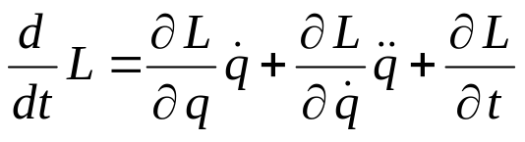



The Euler-Lagrange Equations
To discuss Noether’s theorem at a more advanced level we start first with Hamilton’s principle
Setting the first variation of the functional J to zero yield the Euler-Lagrange equations (ELEs)
The total derivative operator d/dt satisfies
In physical terms, think of as position, as velocity, and as the epoch of an orbital state. You can change any of them while keeping the others constant
C. Schiff/595 3/26/08
Conservation, Symmetry, and Noether

Slide 20
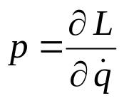


Hunting for Conserved Quantities
A conserved quantity is one whose total time derivative is zero.
The obvious place to start is the ELEs in which d/dt appears
This idea is so important that the name conjugate momentum was invented
But if then L is ‘invariant’ under changes
and there is a symmetry!
C. Schiff/595 3/26/08
Conservation, Symmetry, and Noether

Slide 21
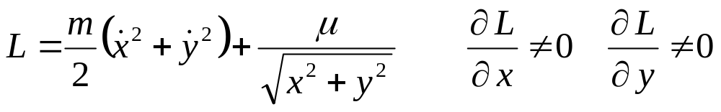
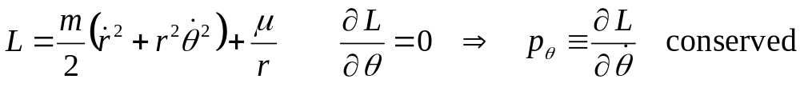
Conservation in the Kepler Problem
We know from the elementary methods shown earlier that energy, angular momentum, and the LLR vector are conserved
Suppose we write down the Lagrangian for the Kepler problem (relative coordinates in the orbit plane) in Cartesian coordinates
So how do we find a conserved momentum?
Transform to polar coordinates
C. Schiff/595 3/26/08
Conservation, Symmetry, and Noether

Slide 22
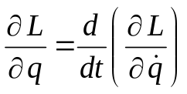
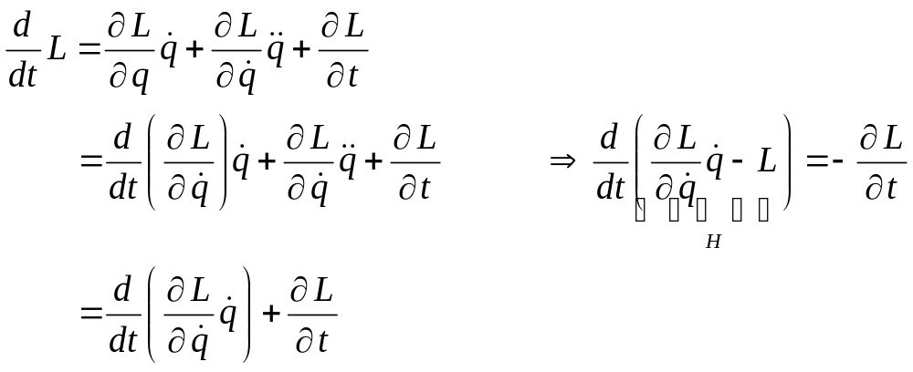
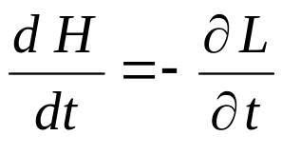
Transforming the ELEs
Take the total time derivative of L
Use the ELEs to eliminate
H is the Hamiltonian
C. Schiff/595 3/26/08
Conservation, Symmetry, and Noether

Slide 23
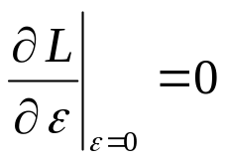
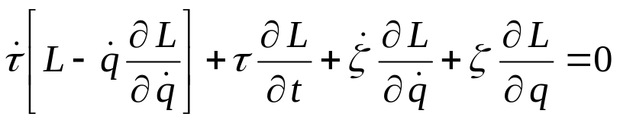
Rund-Trautman Identity
The Rund-Trautman Identity (RTI) offers a systematic way to find conserved quantities assuming a particular symmetry
Assume the following transformations
If the Lagrangian is invariant to first order in ε then
Turning the mathematical crank implied by this invariance yields the RTI
C. Schiff/595 3/26/08
Conservation, Symmetry, and Noether

Slide 24
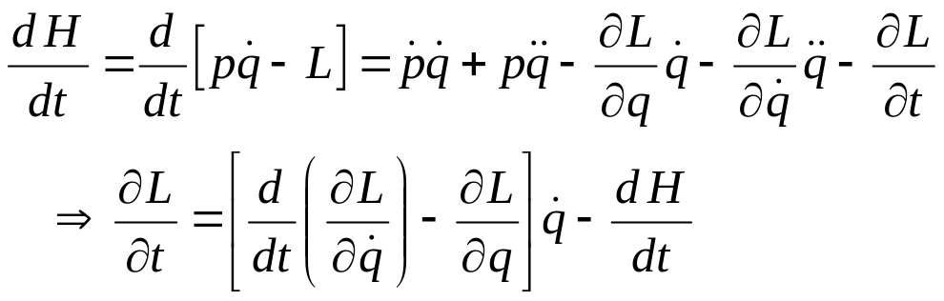

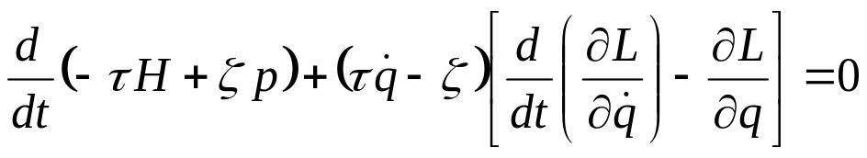
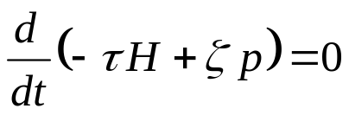
From the RTI to Noether’s Theorem
First consider the total time derivative of the Hamiltonian
Now substitute this result into the RTI and add/subtract
to get [16]
which is Noether’s theorem
For physical motion, the term in the square bracket (which is the ELE) is zero:
C. Schiff/595 3/26/08
Conservation, Symmetry, and Noether

Slide 25
Useful References
Cited
[1] – This talk is inspired by and closely follows the article ‘Symmetries, Conservation Laws, and Noether’s Theorem’, by D. E. Neuenschwander in the fall 1998 issue of Radiations, a publication of Sigma Pi Sigma
[2] – www.wikipedia.org: Noether’s theorem (and links therein)
[3] – www.wikipedia.org: Emmy Noether
[4] – Nina Byers, ‘The Life and Times of Emmy Noether’, xxx.lanl.ogv, hep-th/9411110 v2
[5] – www.wikipedia.org: Laplace-Runge-Lenz vector
[6] – N. W. Evans, ‘Superintegrability in classical mechanics’, Phys. Rev. A 41, 5666
[7] – Bate, Mueller, and White, Fundamentals of Astrodynamics, Dover Publication, Inc., 1971
[8] – E. A. Desloge & R. I. Karch, ‘Noether’s theorem in classical mechanics’, Am. J. Phys. 45, p 337, 1977
[9] – D. E. Neuenschwander & S. R. Starkey, ‘Adiabatic invariance derived from the Rund-Trautman identity and Noether’s theorem’, Am. J. Phys. 61, p 1008, 1993
[10] – D. E. Neuenschwander & G. Taylor, ‘The adibatic invariants of plasma physics derived from the Rund-Trautman identity and Noether’s theorem’, Am. J. Phys. 64, p 1428, 1996
[11] – J. Struckmeier & C. Riedel, ‘Noether’s theorem and Lie Symmetries for time-dependent Hamilton-Lagrange systems’, Physical Review E, vol 66, article 066605
[12] – E. L. Hill, ‘Hamilton’s Principle and the Conservation Theorems of Mathematical Physics’, Reviews of Modern Physics, vol 23, p 253, 1951
[13] – H. Goldstein, Classical Mechanics, Addison-Wesley Pub. Co., 1980
[14] – P. E. Hydon, Symmetry Methods for Differential Equations: A Beginner’s Guide, Cambridge University Press, 2000
[15] – D. Boccaletti & G. Pucacco, ‘Killing equations in classical mechanics’, Il Nuovo Cimento, vol 112, p 181, 1997 (yes it is in English)
[16] – C. Schiff, unpublished notes
Additional
N. Bobillo-Ares, ‘Noether’s theorem in classical mechanics’, Am. J. Phys. 56, p 174, 1988
C. Schiff/595 3/26/08
Conservation, Symmetry, and Noether

